Slide 1

ANZ - Virtual Experience Programs - Forage - Task 1 Exploratory Data Analysis
- Biswabal Gurung

Slide 2
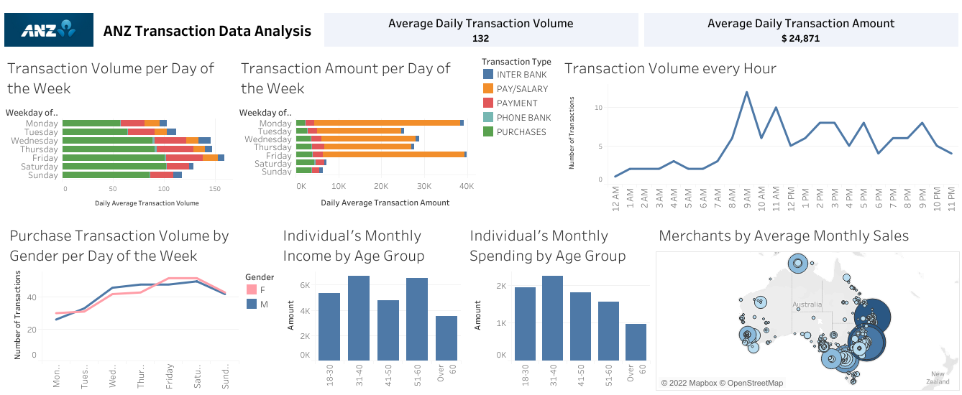

Slide 3
Summary of Findings
Most transaction happens to be on Friday and purchase is the most common type of transaction.
Customer prefers to purchase more on Saturdays and Fridays, especially female customers.
Transaction volumes are high between 9 am till noon.
Salaries are credited only during Weekdays and compared to other types of transaction the average transaction amount for salaries is highest.
Customer between 31-40 years of age tends to have higher income but they also spends more, whereas customer over 60 years has less income and spends less.
The average spending of customers is likely to fall as they grow over 40 years of age.
NSW, Queensland and Victoria hosts some of the top merchants with highest amount of sale.

